Slide 1
IBM University Engagement Project Submission
“Exploring the Power of Agentic AI with IBM Granite and LangFlow”

Slide 2

Project Tile – Smart Industrial Pollution Monitoring for Golden Corridor (Vapi–Ankleswar)
Domain of Project – Environmental Sustainability
Student Name | Recent Passport Photo | Email ID | Mobile number [WhatsApp]
Tarasariya Rinkal Ratilal |  | rinkaltarasariya1002@gmail.com | 6351103051
Recommended font style and size:
Font Style: Arial
Font Size (Heading): 28
Font Size (Content): 20

Slide 3
Problem Statement -
Problem Statement : The Vapi–Ankleshwar–Vatva industrial corridor hosts a high concentration of chemical and manufacturing industries, creating significant environmental monitoring challenges.
The Challenge
The industrial belt along Vapi, Ankleshwar, and Vatva faces significant air and water pollution from chemical and manufacturing units, with limited real-time monitoring and slow regulatory response to violations.
The Objective
1.Continuous Pollution Monitoring
Monitor industrial air emissions and water effluents in real time using sensors and AI-based monitoring systems.
2.AI-Based Violation Detection
Use Agentic AI to automatically identify pollution levels exceeding permitted limits and detect abnormal industrial activities.
3.Intelligent Data Analysis
Analyze sensor data, historical records, and environmental parameters to identify pollution patterns and predict potential violations.
4.Automated Regulatory Alerts
When a violation is detected, automatically generate and send timely alerts to regulatory authorities for quick action.
5.Community Safety Alerts
Provide early warnings to nearby communities when pollution reaches potentially dangerous levels.
6.Automated Reporting & Recommendations
Generate pollution reports, maintain violation records, and provide AI-driven recommendations for corrective and regulatory action.

Slide 4
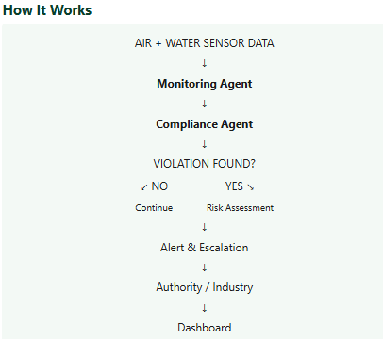
Proposed Solution -
Proposed Solution: Ecosential-AI
“You are EcoSentinel AI, an intelligent Agentic AI system for monitoring industrial pollution in the Vapi–Ankleshwar Golden Corridor. Continuously analyze real-time air-emission and water-effluent sensor data. Monitor pollution parameters against permitted environmental limits, detect abnormal patterns and potential violations, investigate possible causes, assess the severity and environmental risk, prioritize incidents, and automatically trigger appropriate alerts and escalation. Notify industries and regulatory authorities about serious violations, provide community warnings when necessary, maintain a record of incidents, and recommend suitable corrective actions. Continuously learn from monitoring data and previous incidents to improve pollution detection, risk assessment, and response.”

Slide 5
Technology Used
Langflow Platform – For visually designing and orchestrating the multi-agent pollution monitoring workflow.
IBM Granite Model – For natural language understanding, reasoning, violation analysis, risk assessment, and generating alerts/recommendations.
IBM Cloud – For providing a secure and scalable environment to deploy the EcoSentinel AI solution and its agents.
RAG (Retrieval-Augmented Generation) – To retrieve environmental regulations, permitted pollution limits, industrial guidelines, and historical pollution information before generating decisions or recommendations.
IBM watsonx.ai – For AI model deployment, evaluation, governance, and management.
Vector Database (FAISS/Chroma) – For storing and retrieving environmental regulations, pollution guidelines, historical incidents, and other relevant documents used by RAG.

Slide 6
Langflow component Used -
Component | Use in your project
Chat/Input | Receives sensor data or pollution-related queries
Data / File Loader | Loads environmental regulations, pollution standards, and historical data
Split Text | Breaks documents into smaller sections for RAG
Embedding Model | Converts environmental documents into vectors
Chroma / FAISS | Stores and retrieves relevant environmental information
Retriever | Finds relevant pollution limits/regulations
Prompt Template | Gives instructions to the AI agent
IBM Granite Model | Performs reasoning, analysis, and generates responses
Agent | Makes decisions and coordinates tools/workflow
Conditional Router / If-Else | Checks “Violation Found? YES / NO”
Output / Chat Output | Displays alerts, risk assessment, and recommendations

Slide 7
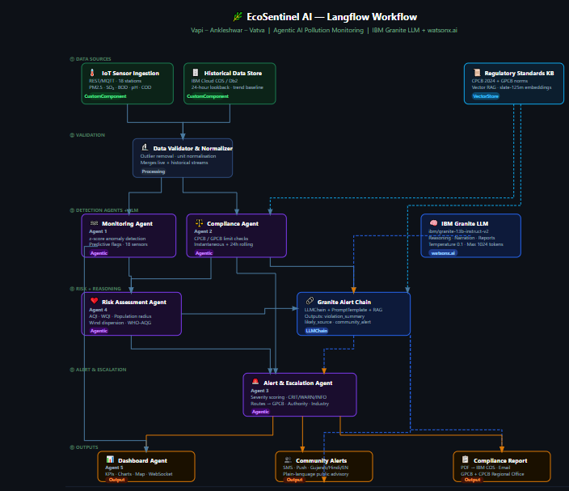
Langflow workflow -

Slide 8
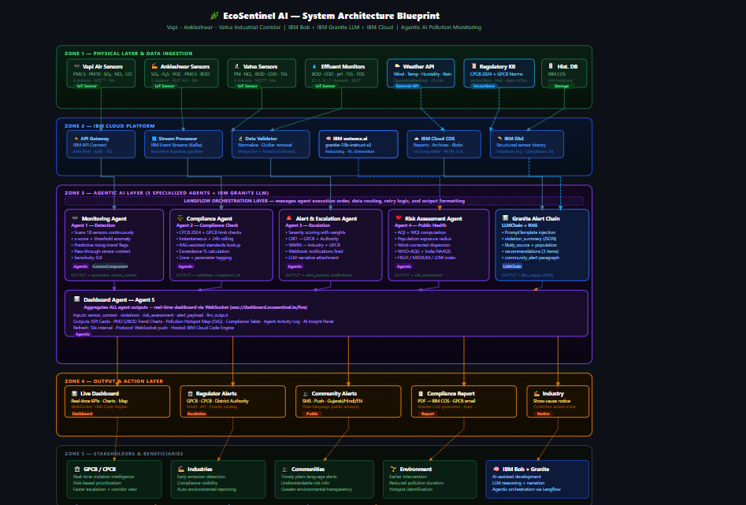
Architecture blueprint

Slide 9

Role of Agentic AI in the solution
Role of Agentic AI :
Continuous Monitoring
Agentic AI continuously analyzes air and water sensor data to identify abnormal pollution levels.
Automatic Violation Detection
It compares sensor readings with environmental standards and permitted limits to detect potential violations.
Reasoning & Investigation
Instead of only detecting an issue, the AI analyzes the data, identifies possible causes, and investigates the situation.
Risk-Based Decision Making
It evaluates the severity and environmental impact of a violation and decides which incidents need immediate attention.
Autonomous Alert & Escalation
Based on the risk level, the system determines whether to alert the industry, regulatory authority, or nearby community.
Actionable Recommendations
The AI recommends corrective actions and helps stakeholders respond quickly to reduce pollution.

Slide 10
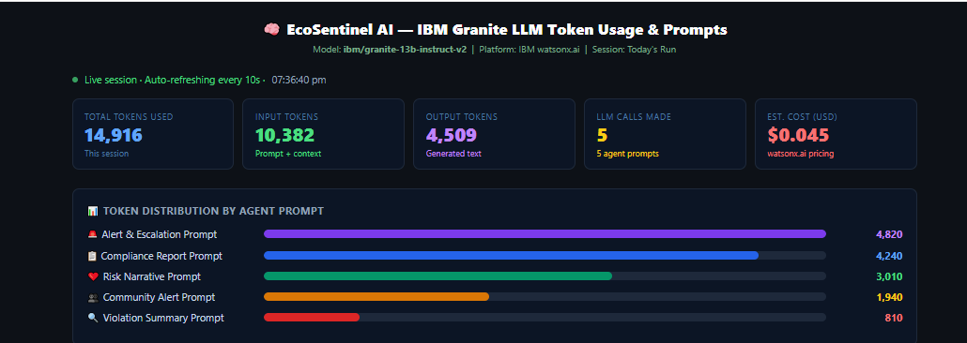
Token Usage
11,761 token are used
·
·
·

Slide 11
Novelty and Uniqueness
Multi-Agent AI Instead of Simple Monitoring
Unlike traditional systems that only display sensor readings, EcoSentinel AI uses specialized agents for monitoring, compliance, risk assessment, alerting, and recommendations.
Real-Time Violation Detection
The system continuously analyzes air and water pollution data and identifies abnormal values or potential violations as they occur.
AI-Based Risk Prioritization
Not every violation has the same impact. The AI evaluates severity, environmental risk, and urgency to prioritize critical incidents.
Automatic Alert & Escalation
When a serious violation is detected, the system can automatically determine who should be alerted—industry, regulatory authority, or nearby community.
RAG-Based Regulatory Intelligence
Instead of relying only on the LLM's knowledge, RAG retrieves relevant pollution standards, environmental regulations, and industrial guidelines before generating its assessment.
From Detection to Action
The key uniqueness is the complete chain:
Observe → Detect → Investigate → Assess → Prioritize → Alert → Recommend Action
This transforms raw pollution data into actionable environmental decisions.

Slide 12
Git Hub Link
Please create public github repository (Enable Add README button while creating repository) with format –
Please test and Paste the working Github URL –
Make sure you have Uploaded following three files into your github repository
1) app.json file , 2) yourproblemstatement.pdf file 3) your projectpresntation.pptx file 4)any other files
·
·
·

Slide 13
Future Scope
🔮 Predictive Pollution Forecasting
Predict pollution events using historical, weather, and sensor trends.
🌦Weather & Environmental Correlation
Combine wind, temperature, rainfall, and other factors to improve risk analysis.
🛰️ Satellite & Remote Sensing
Integrate satellite observations for wider-area environmental monitoring.
🏭 Digital Environmental Twin
Create a virtual representation of the industrial corridor to simulate pollution scenarios.
🤖 Autonomous Investigation Support
AI agents identify patterns and prepare investigation briefs for authorized officials.
🌐Corridor-Wide Expansion
Scale from Vapi–Ankleshwar–Vatva to other ind ustrial zones across Gujarat and India
.
·
·
·

Slide 14
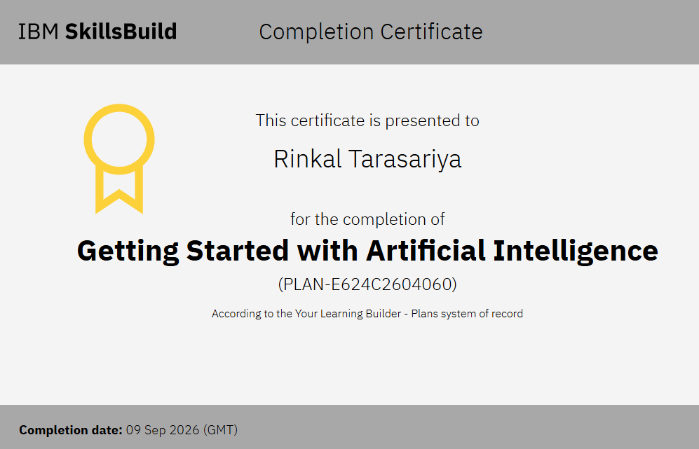
Certificates Earned:
Please add your credly certificate

Slide 15
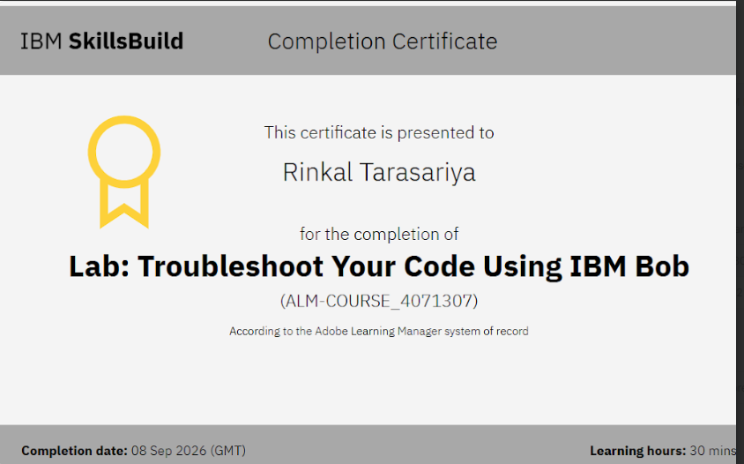
Certificates Earned:​
Add your IBM BOB Certificate

Slide 16


